Slide 1





FINANCIAL SENTIMENT ANALYSIS
MACHINE LEARNING & DEEP LEARNING
MEHMET TAHA BOYNİKOĞLU - MERVE KEDERSİZ - ELİF HANDE ARSLAN

Slide 2

THE CHALLENGE: REAL-TIME MARKET SENTIMENT
The Problem: Financial markets generate massive text data (Twitter, RSS, Reports) per second. Manual analysis is impossible.
Our Goal: Build a "Production-Ready" classifier to detect sentiment (Positive/Negative/Neutral) in <0.01s.
Why It Matters? Algorithmic Trading & Risk Management require speed and accuracy.

Slide 3
DATA COLLECTION PIPELINE
Data Engineering: Scraping & Augmentation
WEB SCRAPING (HYBRID APPROACH):
Custom bots using BeautifulSoup & feedparser.
Sources: Financial News RSS Feeds (Yahoo Finance, Investing.com).
FINAL DATASET
• Total Samples: 3,761
• Real RSS Articles: 451 (Yahoo Finance, CNBC, MarketWatch)
• Split: Train (70%) - Val (10%) - Test (20%)
COMPETITIVE EDGE
Synonym Replacement ("Profit" → "Earnings").
Simulated Social Media Data (Reddit style short-texts).

Slide 4

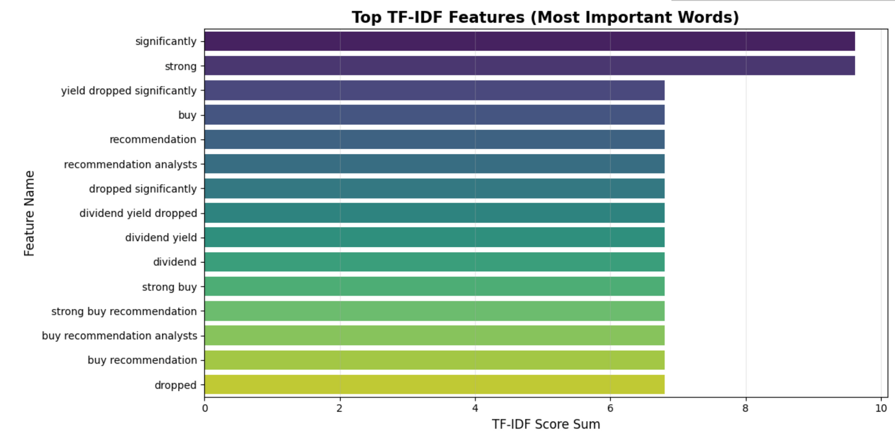

FEATURE ENGINEERING
From Text to Vectors: TF-IDF Strategy:
Method: Term Frequency-Inverse Document Frequency (TF-IDF).
Configuration:
Features: Top 1,000 words.
N-Grams: (1, 3) Captures phrases like "Strong buy" or "Bear market".

Slide 5




L2 Regularization (Ridge): Applied to SVM and Logistic Regression.
Early Stopping: Used in MLP training.
5-Fold Cross Validation: Ensured statistical robustness.
SLIDE 5: MODELS & REGULARIZATION
MODEL SELECTION & OVERFITTING PREVENTION
LINEAR MODELS:
DEEP LEARNING
REGULARIZATION TECHNIQUES
ENSEMBLE
Logistic Regression
Linear SVM.
Random Forest.
Multi-Layer Perceptron (MLP).

Slide 6



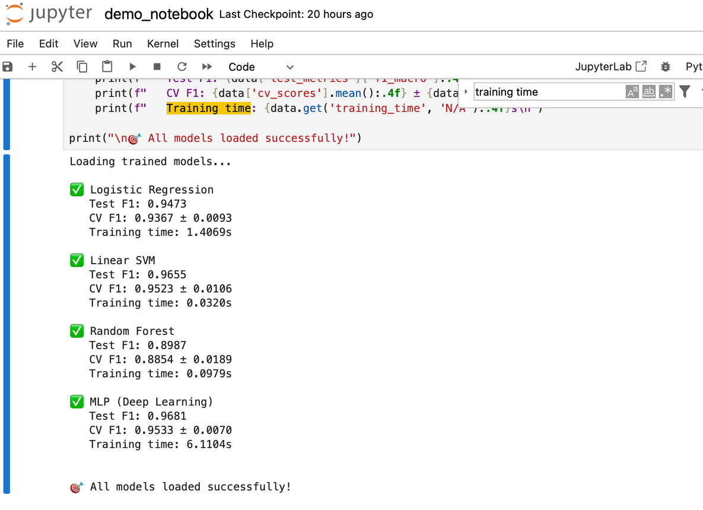

Key Takeaway:
"Deep Learning (MLP) achieved best performance with 96.81% F1-Score"
RESULTS COMPARISON
I

Slide 7

CONFUSION MATRIX
Detailed Error Analysis
TEST SET: 753 SAMPLES
PERFORMANCE BY CLASS:
01
Positive: 97% F1
F1 (Excellent detection of "Gains/Growth").
03
02
Neutral: 96% F1
Negative: 97% F1
F1 (Most challenging class).
F1 (Good detection of "Losses/Risk").

Slide 8

ERROR ANALYSIS & INSIGHTS
Why do we miss?
COMMON ERROR PATTERN:
Neutral → Positive Misclassification
CASE STUDY:
Text: "The market remained steady throughout the day."
Prediction: Positive (Wrong) | Actual: Neutral
Reason: Words like "steady" or "stable" generally have positive connotation in general English, but are Neutral in finance.
ROBUSTNESS
Despite noise and sarcasm in social media data, the model maintained >90% accuracy.

Slide 9


CONCLUSION
CONCLUSION & FUTURE WORK
Achievements:
Built a custom dataset (3,761 samples)
451 Real RSS articles
753 test samples
Achieved 96.81% F1-Score with MLP Deep Learning
Future Improvements:
Integrate FinBERT (Transformer) to improve 'Neutral' class detection.
Deploy as a real-time REST API for live trading.

